Slide 1

COMP 90049
Knowledge Technologies
Week 6
我们毕业啦
其实是答辩的标题地方
Tutor
Ang Li

Slide 2
Name: Ang Li
E-mail: angl4@student.unimelb.edu.au
Contact information
Research topic: computer vision

Slide 3
Summery
Work through this week’s exercise
Notes:
Secure File Transfer Protocol
Secure Shell

Slide 4
Exercise 1. What are the four tasks into which a Web-scale information retrieval engine is usually divided?
Briefly summarise each one.

Slide 5
Crawling: finding and downloading as many documents as we can from the web (hopefully all of them, although this isn't possible in practice)
Parsing: turning each document into a list of tokens (or terms), probably by removing page metadata, case folding, stemming, etc.
Indexing: building an inverted index out of all of the tokens in our downloaded document collection. (We stop worrying about the original documents at this point.)
Querying: after the previous three steps have been completed (off-line), we are ready to accept user queries (on-line), in the form of keywords, that we tokenize and then apply our querying model (e.g. TF-IDF) based on the information in the inverted index, to come up with a document ranking.

Slide 6
Exercise 2. When parsing Web pages:
What is “tokenisation"? What are some common problems that arise in tokenisation of English text? What about other languages?
What is “stemming"? How might it be different in languages other than English?

Slide 7
Tokenisation is the act of turning the raw text of a document into tokens that we will use to compare against the query, for example, by removing punctuation, folding case and so on.
In English, there are many issues: for example, contractions - is “can't” one token or two? The lectures discuss many examples of this.

Slide 8
The lectures discuss stemming - the process of removing morphological affixes to arrive a sort-of “base form" for a token.
The problem, of course, is that dierent languages use dierent approaches for stemming.

Slide 9
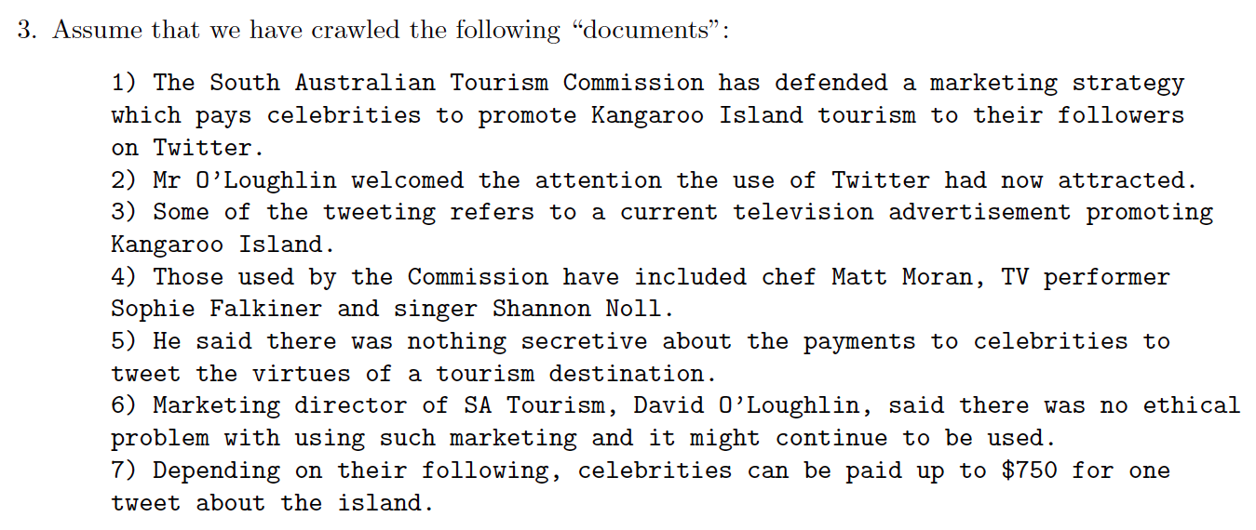

Slide 10
Parse each document into terms.
Let's consider a term to be a token with whitespace (\b) on either side. Let's also strip punctuation and fold case.

Slide 11
Construct an inverted index over the documents, for (at least) the terms and, australia, celebrity, commission, island, on, the, to, tweet, twitter

Slide 12
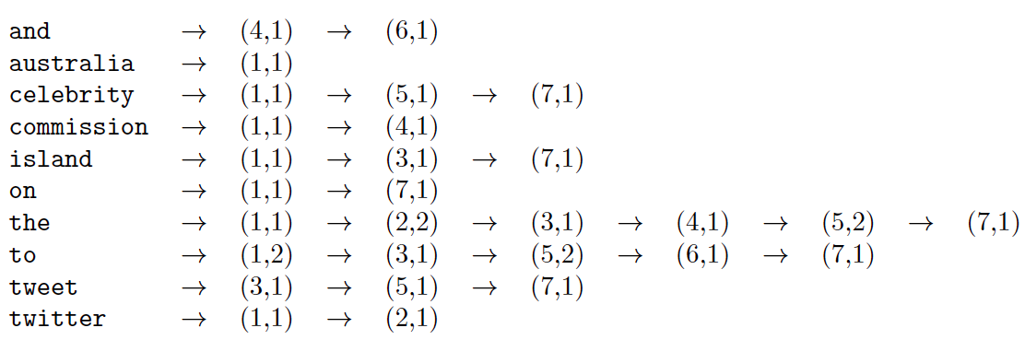
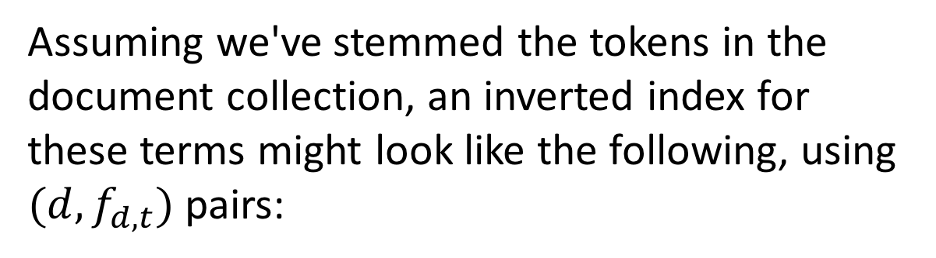
Assuming we've stemmed the tokens in the document collection, an inverted index for these terms might look like the following, using $(d, f_{d, t})$ pairs:

Slide 13
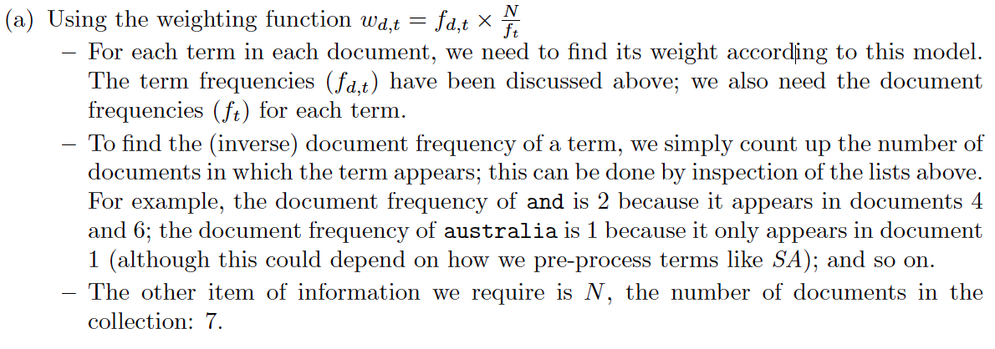
Using the vector space model and the cosine measure, rank the documents for the query “commission to island on twitter”

Slide 14
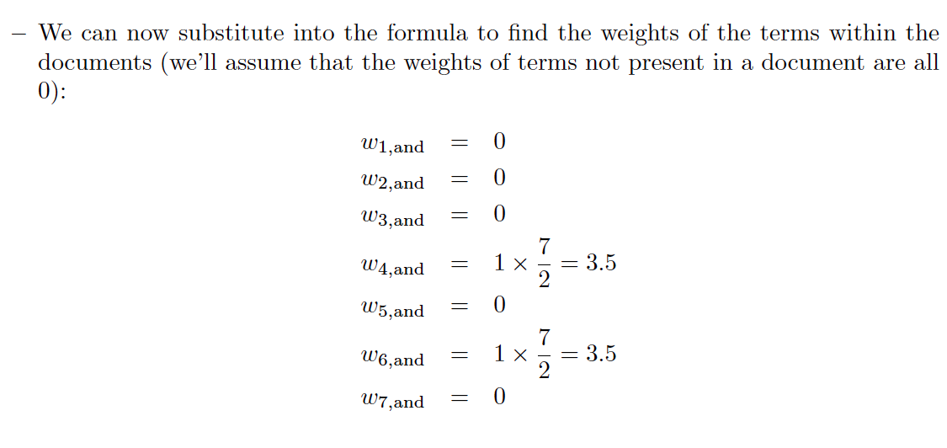

Slide 15
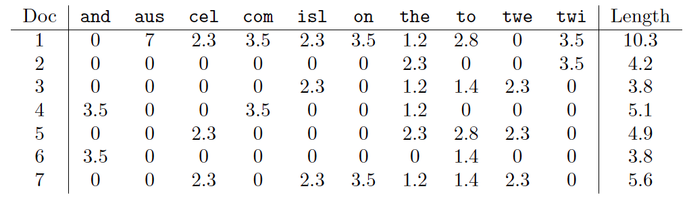

Slide 16
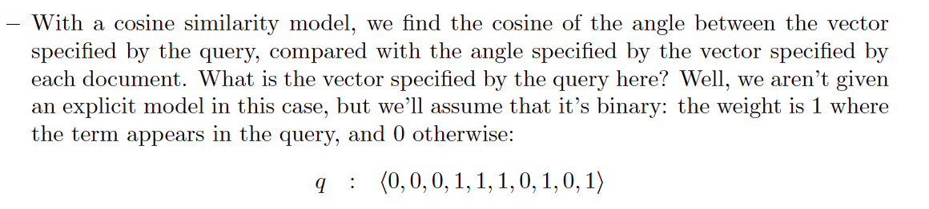

Slide 17
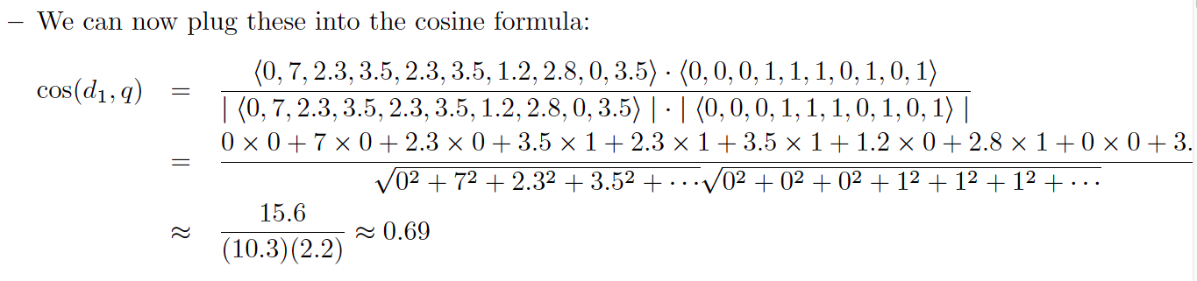

Slide 18
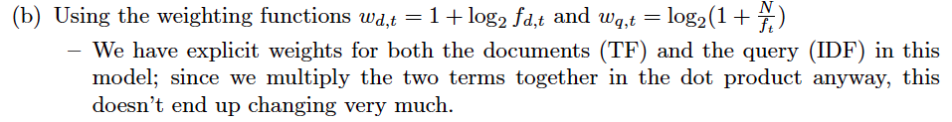

Slide 19
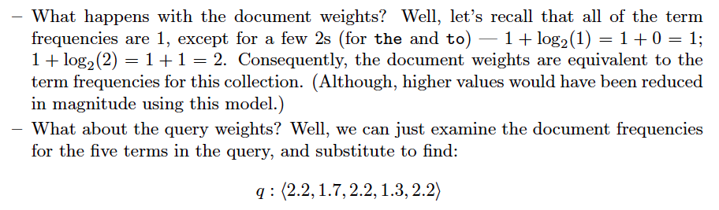

Slide 20
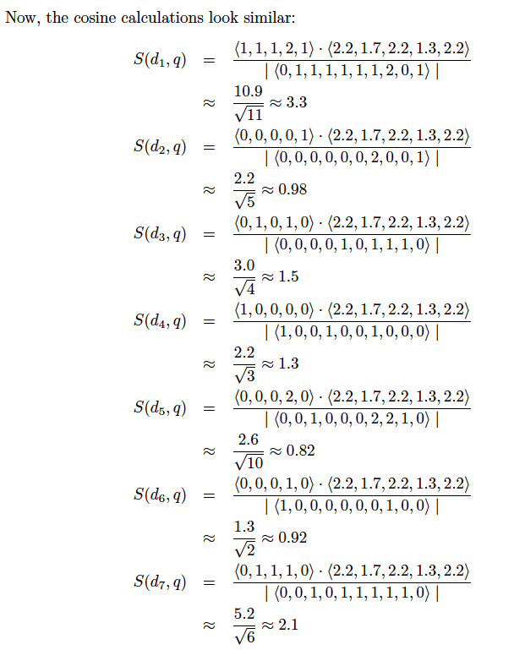

Slide 21
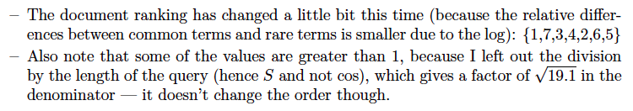

Slide 22
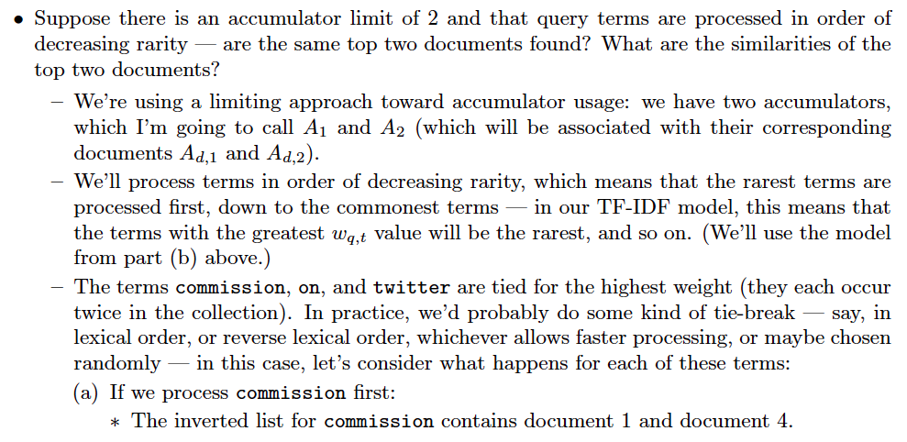

Slide 23
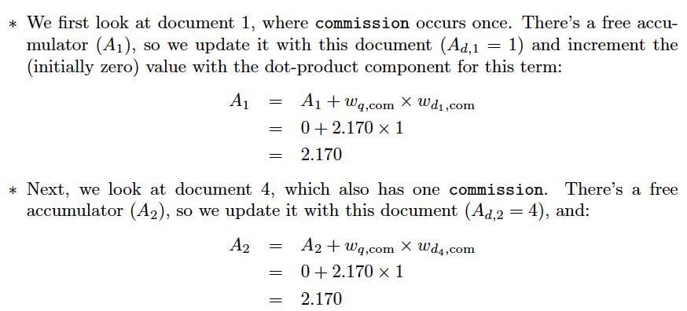

Slide 24
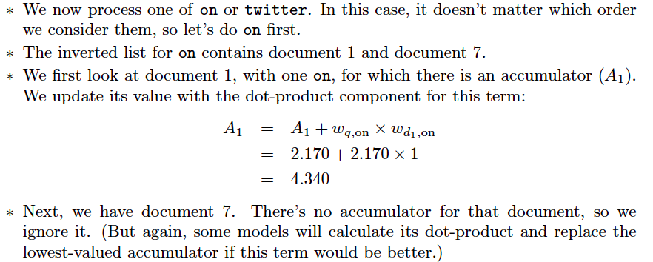

Slide 25
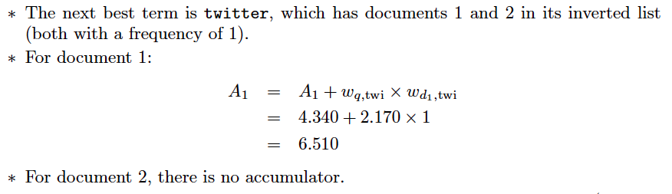

Slide 26
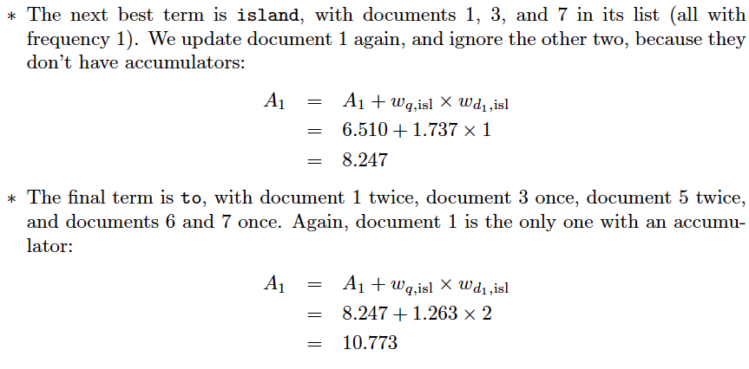

Slide 28
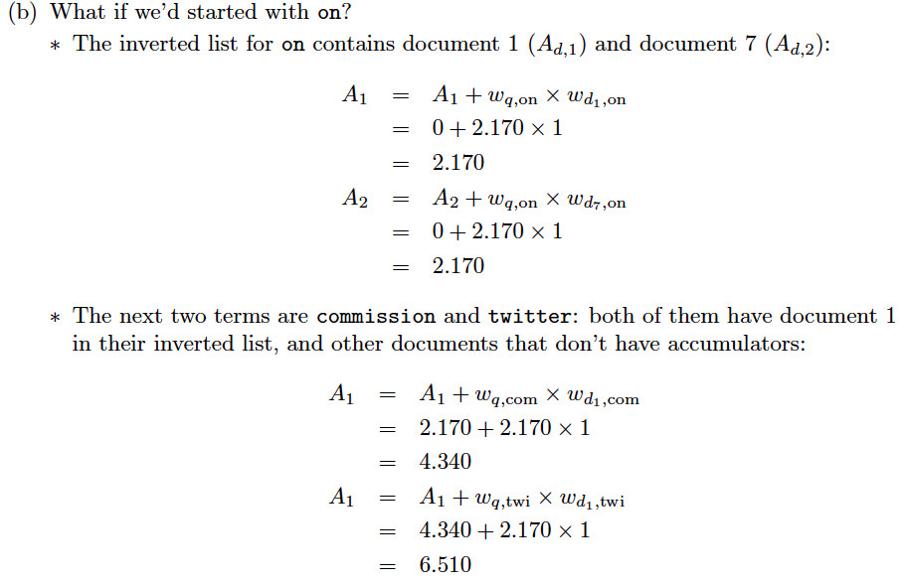

Slide 29
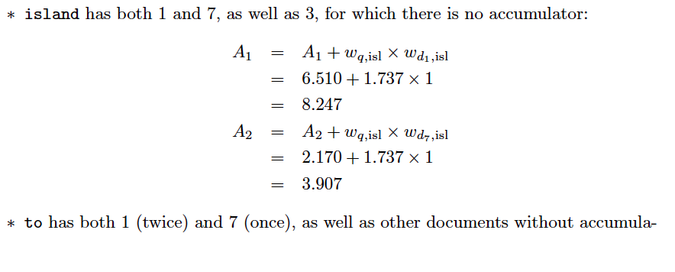
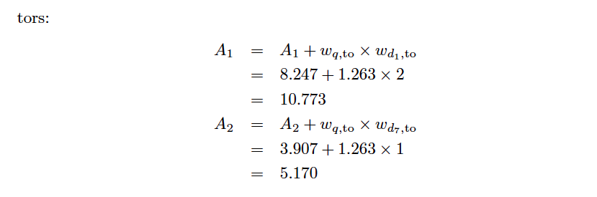

Slide 30
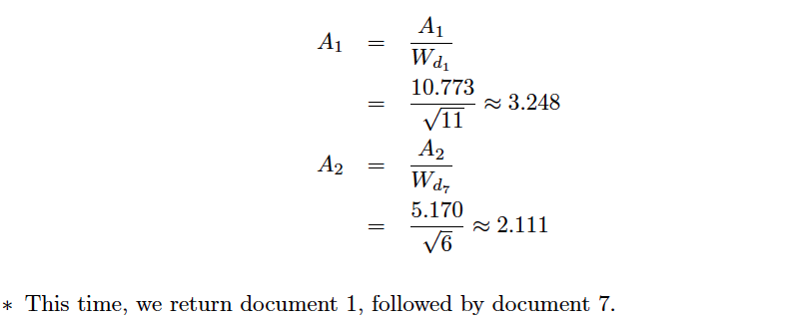

Slide 31
Thanks!

